Slide 1
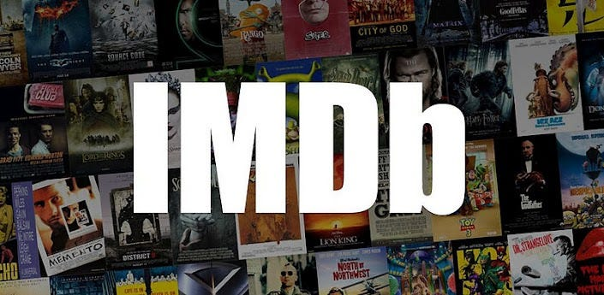
IMDB Movie Analysis
By Sudhansu

Slide 2
AGENDA
Project Description
Approach
Tech-Stack Used
Insights
Result
Excel workbook hyperlink : click on this
Cleaned dataset data cleaning steps & visualisations

Slide 3

Project Description
Dharma production is facing losses due to flop of last few movies. They have usually released movies for the Indian audience but for their next project they are planning to release a movie for the global audience.
Thus helping the company to plan their every move analytically based on data. Generating meaningful insights from the IMDB dataset that can help them to make movie that appeals to both Indian and global audience while minimizing the risk of losses.

Slide 4
Approach
Downloaded and imported the dataset in the excel, performed data cleaning i.e. removing missing & invalid rows and handling outliers. Used pivot table and excel chart to draw graphs and finding insights. And finally drawn conclusions from insights and made recommendations
Root cause analysis : 5 Whys approach
Why last few movies flopped?
Ans: because they failed to impress both critics and the audience.
Why they failed to impress?
Ans: because they gave the audience something that they couldn’t be satisfied with.
Why they are not able to satisfy the audience?
Ans: because of miscasting of actors & directors as well as poor selection of genre and storyline.
Why they mis-casted & selected poor story?
Ans: because they didn’t used data driven decision making to track audience preference & trends in the film industry.

Slide 5
Impact
Meaningful insights from data analysis will help in :
Tracking audience preferences and identifying target audience
Trends in film industry, trending genres and story
Determining budget and minimizing the risk of losses
Tech-Stack Used
Used Microsoft Excel version 2305, for data cleaning and visualizations. As Excel offers several powerful tools for data visualization that can help you analyze and understand your data better. With features such as charts, graphs, pivot tables, and other formatting options.

Slide 6
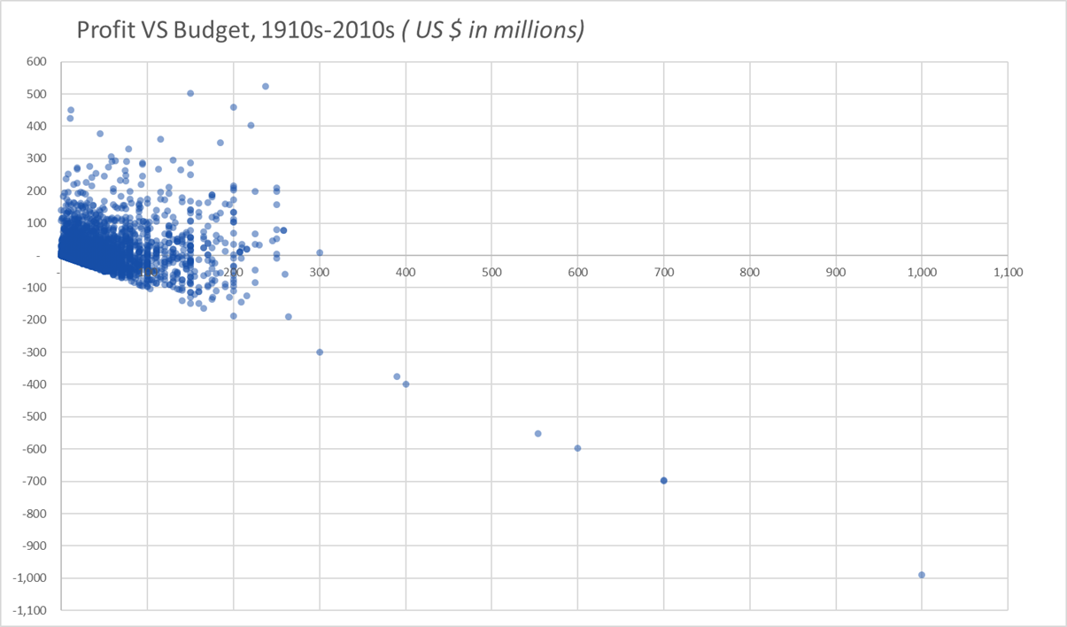
Insights
There is no strong correlation between budget and profit except that the huge loss making movies are very high budget movies
Top 10 movies by profit
Avatar is the most profitable movie followed by Jurassic world which are high budget movies
Star Wars and E. T. the Extra-Terrestrial are high profit making movies despite being quite low budget

Slide 7
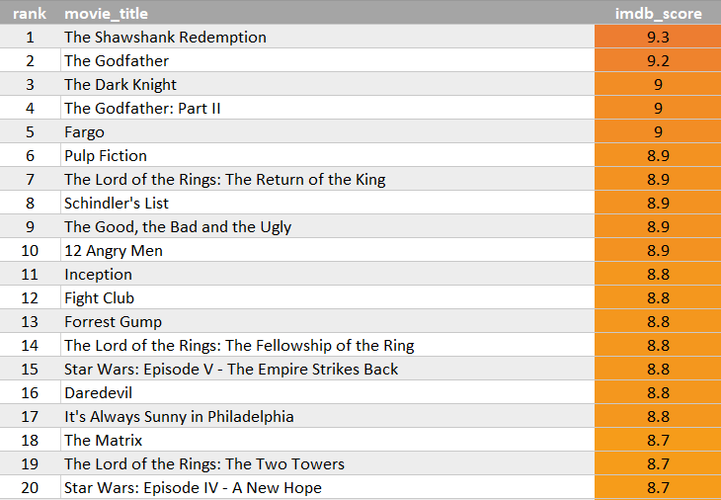
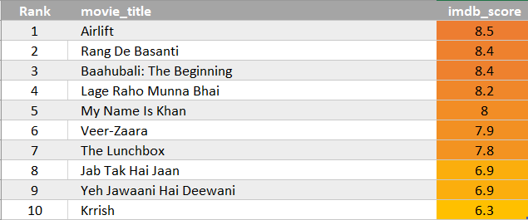
The Shawshank Redemption is the highest rated movie around the globe whereas Airlift is the highest rated Indian movie among the Top 250 IMDB rating movies
IMDB top 250 rated movies, users vote greater than 25k
IMDB top 10 rated Indian movies, users vote greater than 25k

Slide 8
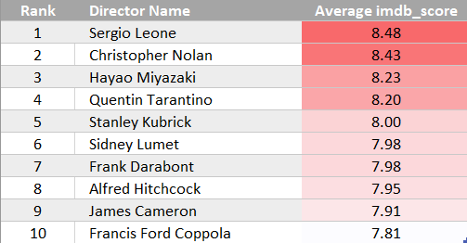
Sergio Leone and Christopher Nolan are the top 2 directors in the world
Top 10 directors by avg. IMDB score
These are the names of top 10 directors calculated by sorting their name by mean of imdb_score of those directors with movies greater than 3 in top 250 imdb movies
And number of voted users greater than 25000

Slide 9
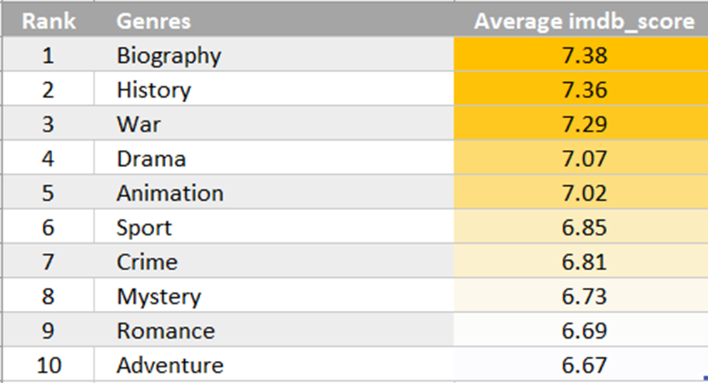
Biography is the genre with highest average IMDB ratings around the globe
Top 10 Genres by avg. IMDB score
These are the names of top 10 genres calculated by sorting their name by mean of imdb_score of those movies which has number of voted users greater than 25000

Slide 10
Leonardo DiCaprio is the most favourite actor among the critics as well as the audience
Top 3 critic – favourite actors
These top actors are ranked by mean of number of critic reviews and user reviews
Only those movies of actors are taken in consideration for mean review calculation in which they are in lead role
Top 3 audience – favourite actors

Slide 11
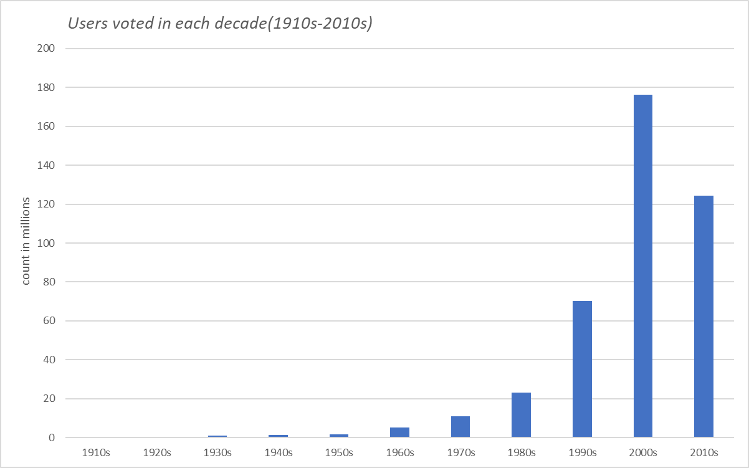
Users vote count increased from ~10k in 1910s to ~180 million in 2000s
Sum of users vote increased exponentially to all time high in 2000s
Bars are calculated by taking sum total votes of users for all movies in each decade

Slide 12
Results
Conclusions and recommendations :
Most profitable movies are in the range of $100million to $300million, the company can keep their budget between this range to minimize the risk of loss.
Shawshank Redemption followed by The Godfather and The Dark Knight are the highest IMDB rated movies around the world, the company can take inspiration from plot of these movies.
Sergio Leone, Christopher Nolan and Hayao Miyazaki are the top 3 directors with highest mean IMDB rating movies in the world, the company can work in collaboration with these directors.
Biography, History and War are the top 3 genres with highest mean IMDB rating movies in the world, the company can choose genre for their next movies from these.
Leonardo DiCaprio is the most favourite actor among the critics as well as the audience around the world, the company can cast him or can add a cameo role in the movie to create hype among the fans for the movie.

Slide 13
Thank you

